Slide 1
Performance Appraisal

Slide 2
What is performance appraisal?
Performance appraisal is the process of evaluating and documenting an employee’s performance with a view to enhancing work quality, output and efficiency. Performance appraisals perform three important functions within companies.
They provide feedback to a person on their overall contribution for a period.
They identify development needs and opportunities for improvement.
They help inform salary and bonus reviews.

Slide 3
6 Steps To A Successful Performance Appraisal?
In most effective performance appraisal processes, an employee and their manager will meet at regular intervals to:
reflect on what is required of the employee to do their job well (including behaviour and results)
set goals that will benefit the individual and the business
share feedback on great work as well as areas for improvement
identify opportunities to develop performance through ongoing education, training and learning
formally review performance after a specific period
reward a job well done

Slide 4
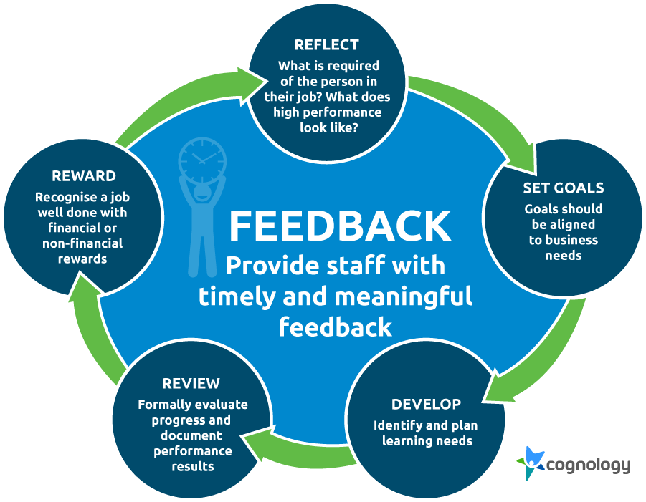

Slide 5
REFLECT
Effective performance appraisal starts with an accurate understanding of what is expected of a person in their job. To achieve this, it helps to reflect on:
why a job exists;
where it fits into the organization;
how it contributes to the overall objectives of the organization and current business strategy;
what is expected of the person’s performance (including behaviors, compliance with policy and process, and results);
what competencies (knowledge, skills and abilities) are required.

Slide 6
It is also important to help staff take a step back to look at their past performance.
what results have they produced?
how have they behaved with customers, suppliers, colleagues, and supervisors?
how have they demonstrated the organisation’s values?
have they followed process and procedures?
what has been their biggest challenges?
how will they adapt to any changes ahead?

Slide 7
SET GOALS
Employee goals will usually focus on an aspect of their performance they want to work on or be better at. Goals may also reflect the employee’s ambitions for their career.
A manager’s role will be to ensure that the person’s goals are consistent with and support the priorities and strategy of the business. However according to the Society for Human Resource Management (SHRM), to ensure understanding and commitment from both sides the process must remain participative – in other words, both the manager and individual should be involved. SHRM also recommends that staff only focus on a few major goals at a time and that goals should be SMART. (Specific, Measurable, attainable, Relevant, Time bound)

Slide 8
FEEDBACK
Regular feedback is the linchpin of successful performance appraisal, but it doesn’t always have to involve a scheduled sit-down meeting. Some of the best feedback occurs spontaneously – in the moment, on the job. What is important is that the feedback is timely and meaningful.
To get the most rounded and accurate feedback on performance, it may be useful to look for sources outside of the traditional manager – employee relationship.

Slide 9
This is where processes like 360 degree feedback have been of value. 360-degree feedback, sometimes referred to as multi-rater appraisals or multi-source feedback is a tool designed to address the problem of bias. Instead of relying on the feedback of one person, with 360 feedback a person gains feedback from peers, reports, managers and even internal and external customers. This removes the problem of bias and provides a person with valuable insight into how others see them.

Slide 10
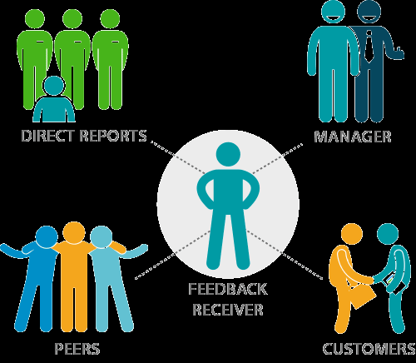

Slide 11
DEVELOP
With a good understanding of how an individual is tracking against performance expectations, it should be easy to identify and prioritize education, training, or other learning opportunities that will help them achieve their goals.
Development activities may involve formal accreditation eg degrees, diplomas and certificates, or could include more flexible or low cost options like eLearning, research projects, one on one coaching, shadowing, and peer collaboration.

Slide 12
REVIEW
After 6 or 12 months, managers may schedule a formal review to look back, assess and document what has been achieved against specific performance requirements and goals.
Reward
A formal review process is particularly important for organizations that have a reward process based on performance. Reward can take the form of salary increases, bonus payments and other monetary incentives however it can also take the form of non-financial rewards including awards, enhanced decision making, more interesting work and promotional opportunities.

